Slide 1





Building DevSecOps: Crafting Secure and Seamless Developer Experiences
Jinhong Brejnholt
Chief Cloud Architect & PO @ Saxo Bank Cloud Native Copenhagen Organizer
jbrejnholt
Notes:
My name is Jinhong, today we are going to talk about one of my favorite topics - security

Slide 2

Agenda
Who
Why
What
How
Demo
Discussion
jbrejnholt

Slide 3



Fast & Secure
Notes:
A bit about me. I'm a mom of a 5 year old, I work at Saxo as Chief Cloud Architect and Product Owner, and I talk a lot about open source. My love to open source is displayed as the number plate in my car ☺
I like to do things in fast and secure way – and that’s what this talk is about.

Slide 4

jbrejnholt
Notes:
“Saxo Bank is a very different bank, and we want our environment to reflect that. The T-Rex that hangs in the canteen reminds us that we need to remain agile and be on the leading edge of technology developments so that we can continue to help our clients and partners navigate the global markets. In other words, we cannot become dinosaurs.” --Kim Fournais, CEO and Founder, Saxo Bank
Saxo Bank is a Danish investment bank specializing in online trading and investment. It was founded as a brokerage firm in 1992, under the name Midas Fondsmæglerselskab, by Lars Seier Christensen, Kim Fournais, and Marc Hauschildt. The name was changed to Saxo when the company obtained a banking license in 2001.
Saxo Bank A/S is a fully licensed and regulated Danish bank with an online trading platform that empowers you to invest across global financial markets.

Slide 5

Why Devsecops
Data Lost
Software Vulnerabilities
Unauthorized Access
System Compromised
jbrejnholt
Notes:
Why do we need to embed security into DevOps
there are vuln in the sw we build
You are only as strong as your weakest link
to protect the intellectual properties/assets
we need to build security into the dev/release process

Slide 6

jbrejnholt
Notes:
What’s security – find the balance
Introduce the topic of the presentation and why it's important.
Briefly mention the risks associated with software development in enterprise environments.

Slide 7

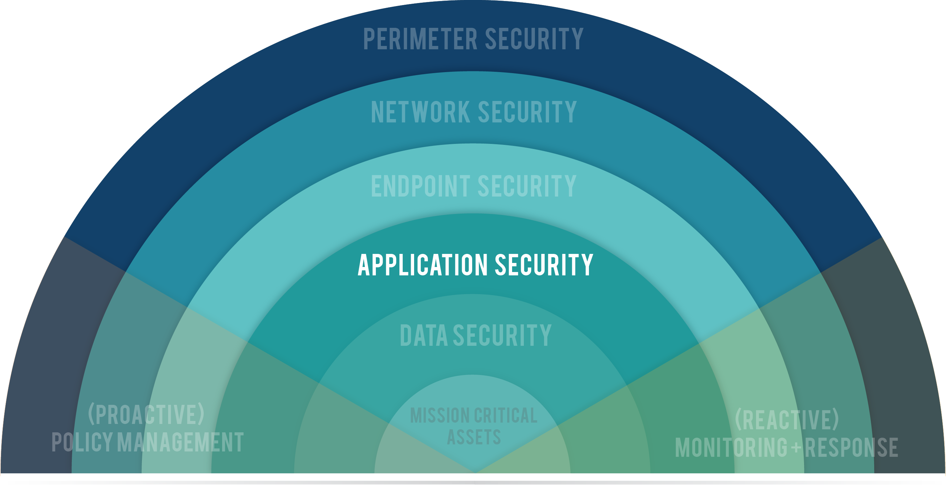
Layered security
jbrejnholt
Notes:
Defense in depth is a strategy that employs a series of mechanisms
to slow the advance of an attack aimed at acquiring unauthorized access to information.
Each layer provides protection so that if one layer is breached,
a subsequent layer is already in place to prevent further exposure.

Slide 8

Run
Release
Check
Build
Plan
jbrejnholt
Notes:
Key technologies and tools
Discuss key technologies and tools that can help streamline the security process.
Mention automated code analysis, vulnerability scanning, and runtime threat prevention and detection.

Slide 9
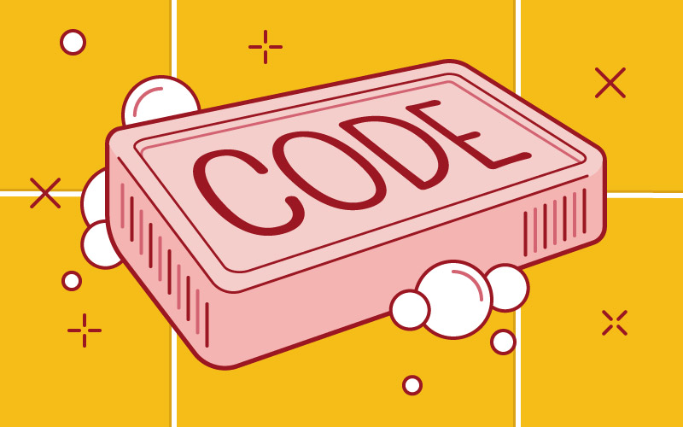
Clean code

Slide 10

Tools

Slide 11
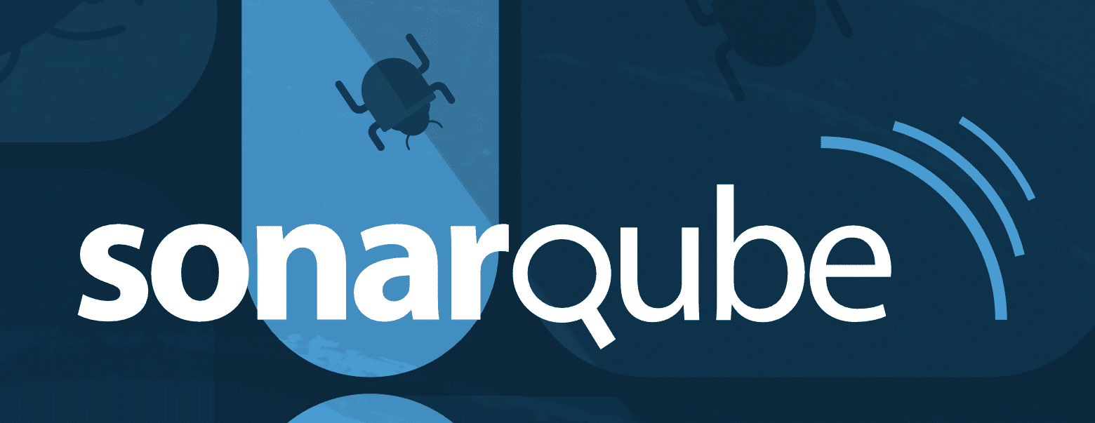
Tools - paid

Slide 12

Development - release
jbrejnholt
Notes:
While devops speed up the software development process – it also need to be protected

Slide 13

jbrejnholt
Notes:
Nowadays, you don’t write everything from the ground up
Building blocks and make a house with your personal/enterprise touch
among those building blocks, you will find a lot open source

Slide 14

jbrejnholt
Notes:
https://www.activestate.com/blog/how-software-bill-of-materials-sboms-support-secure-development/

Slide 15

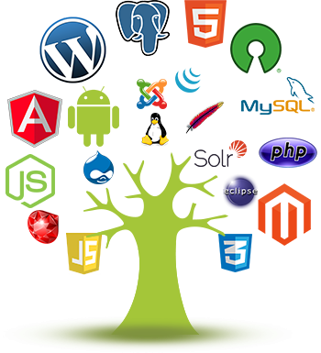
Licensed to use
Transparency
Easy integration
No vendor lock-in
Quality & flexibility
Great learning source
Environmentally friendly
jbrejnholt
Notes:
https://www.activestate.com/blog/how-software-bill-of-materials-sboms-support-secure-development/

Slide 16

CVE
License
Community
jbrejnholt
Notes:
Questions? common vulnerabilities and exposures
Permissive (MIT, Apache 2.0) vs Copyleft (GPL, AGPL)
What is an Open Source Copyleft License? According to the GNU, the founding fathers of the copyleft open source license, copyleft is a method for making a software program free, while requiring that all modified and extended versions of the program also be free, and released under the same terms and conditions

Slide 17
CVE
License
Community
Scan + Remediation
Blacklist + Scan
Pick the right maintainer group
jbrejnholt
Notes:
https://www.activestate.com/blog/how-software-bill-of-materials-sboms-support-secure-development/
What is an Open Source Copyleft License? According to the GNU, the founding fathers of the copyleft open source license, copyleft is a method for making a software program free, while requiring that all modified and extended versions of the program also be free, and released under the same terms and conditions
Frequent release cycle
Wouldn’t that be nice .. Software vendors come with a SBOM, and a

Slide 18


Regulations
May 2021, US
Executive Order on Improving the Nation’s Cybersecurity
Sep 2022, EU
European Cyber Resilience Act
jbrejnholt
Notes:
https://www.activestate.com/blog/how-software-bill-of-materials-sboms-support-secure-development/
– The European Cyber Resilience Act is a proposed piece of legislation designed to strengthen the cybersecurity of critical infrastructures across the EU.
horizontal cybersecurity requirements for products with digital elements and amending Regulation (EU) 2019/1020

Slide 19




US regulation
Maintaining source code security
Vuln & license
Evaluate risk
Review risk from new vuln
jbrejnholt
Notes:
mandates that the government will require baseline security standards for any software its purchases.
The two directives also go so far as to specify the responsibility of the vendor and buyer:
Software developers are responsible for maintaining source code security
Software buyers and operators must:
Perform vulnerability and license analysis
Evaluate a software product’s risk
Review potential risks from newly discovered vulnerabilities
https://www.darkreading.com/application-security/artifact-poisoning-github-actions-malware-software-pipelines
https://www.activestate.com/blog/how-software-bill-of-materials-sboms-support-secure-development/

Slide 20



Tools
Software Bill of Materials (SBOM) generator - syft
Vulnerability detecting scanner – grype
Both - trivy
jbrejnholt
Notes:
App Apache 2.0 license

Slide 21
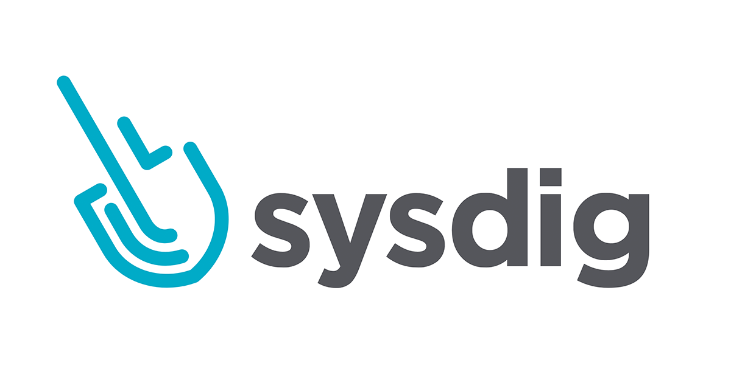
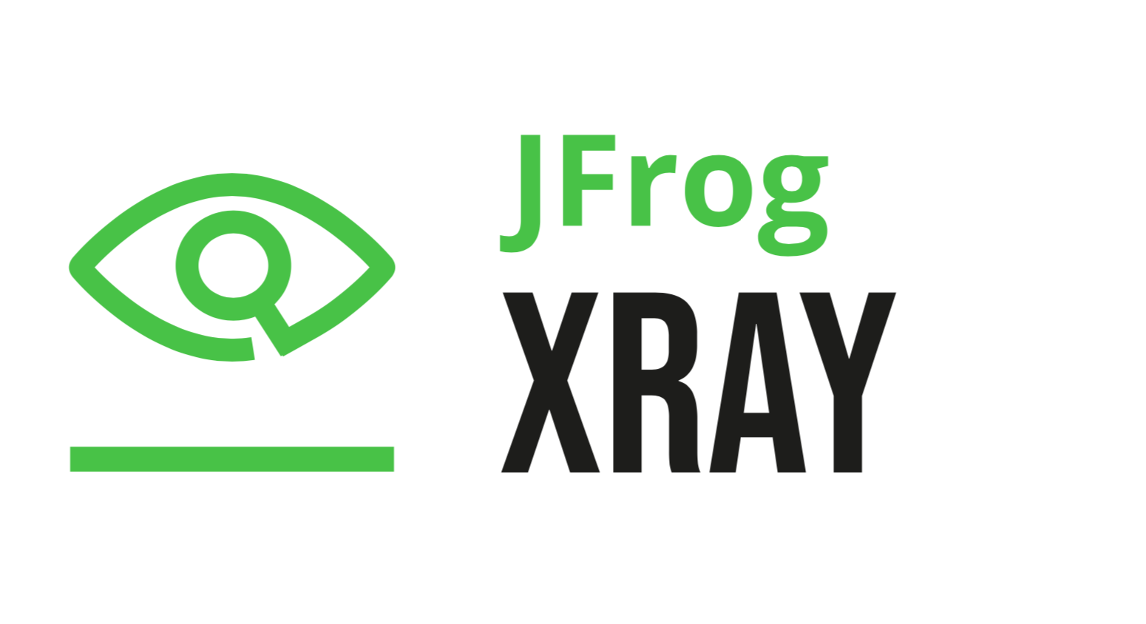
Tools - paid
jbrejnholt
Notes:
App Apache 2.0 license

Slide 22


CICD
Code Quality
Test Coverage
License Scanning
CVE Scanning
Commit Signing
Image Signing
Git
Access Provisioning
Secret Handling
Policy Enforcement
jbrejnholt
Notes:
What is the OWASP Top 10?
Injection. ...
Broken Authentication. ...
Sensitive Data Exposure. ...
XML External Entities (XEE) ...
Broken Access Control. ...
Security Misconfiguration. ...
Cross-Site Scripting. ...
Insecure Deserialization.
Using Components With Known Vulnerabilities
Insufficient logging and monitoring

Slide 23

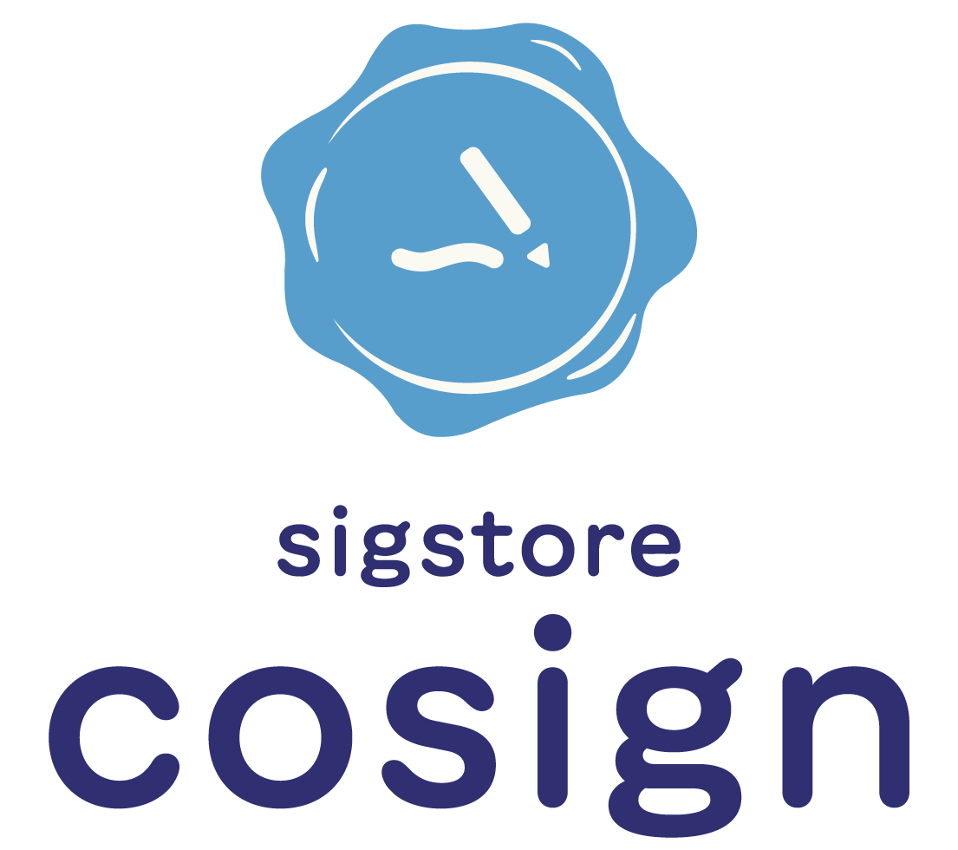



Tools
Image Signing - Cosign
Encrypt secrets before storing in git – Sealed Secrets
Static analysis tools – Analysis tools
jbrejnholt
Notes:
Analysis tools git: for all programming languages, build tools, config files and more
Apache 2.0 and MIT

Slide 24

jbrejnholt
Notes:
I just want to test, why so serious so early

Slide 25

jbrejnholt
Notes:
Be environment specific – not one size fits all

Slide 26

Block with error Very limited access
Production
Block with error Full access
Test
Warnings without blocking Full access
Dev
jbrejnholt
Notes:
Be environment specific – not one size fits all

Slide 27

Backup and restore
Resource monitoring
CVE monitoring
Unscanned img monitoring
Behavior monitoring
jbrejnholt
Notes:
4 golden signals:
Latency
Traffic
Error
Saturation

Slide 28
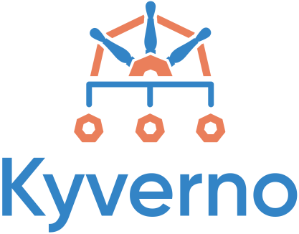


Tools
Policy enforcement including image signature verification - Kyverno
Runtime security – Falco
Kubernetes cluster security check – kube-bench
jbrejnholt
Notes:
Apache 2.0

Slide 29

Wrap Up
Why
Open Source Security
Build security into CICD process
Create separation of environments
Continue monitoring at run time
jbrejnholt
Notes:
Why embed security in DevOps process
How to use Open source securely
Build security into CICD process
Separation of environment to boost productivity
Continue security monitoring at run time as things change

Slide 30

jbrejnholt
Notes:
How secure is the software development lifecycle at your company?

Slide 31
Thank You
jbrejnholt

Slide 32

References
Static Analysis
https://github.com/analysis-tools-dev/static-analysis
Executive Order on Improving the Nation’s Cybersecurity
https://www.whitehouse.gov/briefing-room/presidential-actions/2021/05/12/executive-order-on-improving-the-nations-cybersecurity/
The European Cyber Resilience Act
https://eur-lex.europa.eu/legal-content/EN/TXT/HTML/?uri=CELEX:52022PC0454&from=EN
Choose an open source license
https://choosealicense.com/
jbrejnholt

